Slide 1
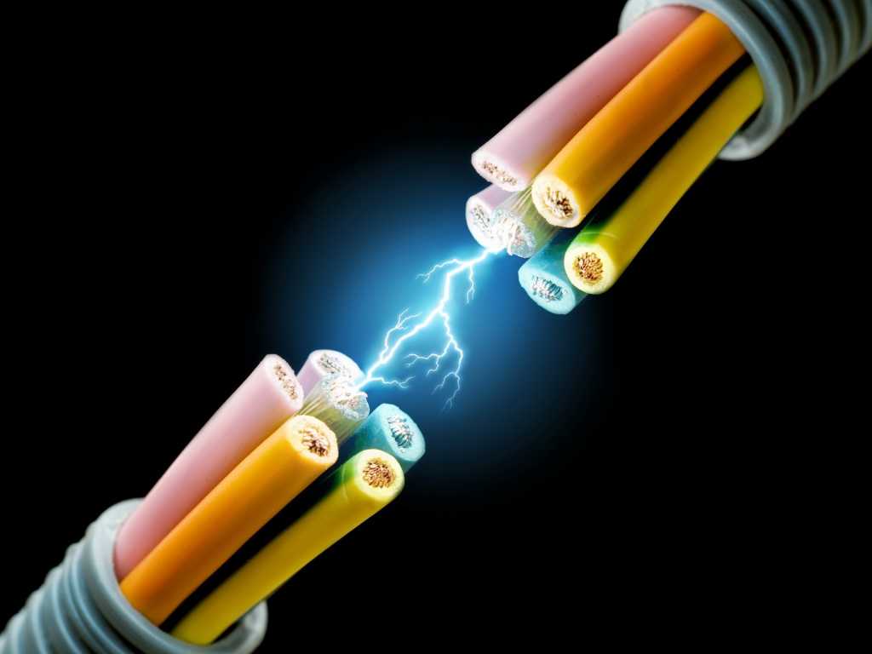
CH 11: Electricity and Its Production
11.3 – Electric Potential Difference
11.5 – Electric Current

Slide 2
Agenda
Section 11.3 & 11.5
Homework problems

Slide 3
A life without Electricity
http://www.youtube.com/watch?v=jv4eWINzoEo

Slide 6
Practice #1 pg. 511

Slide 12
11.5 – Electric Current

Slide 22
Practice #1 pg. 517

Slide 23
Practice #2 pg. 517

Slide 30
Classwork & Homework
Pg. 513 #1-9 and Pg. 518 #1-9

