Slide 1
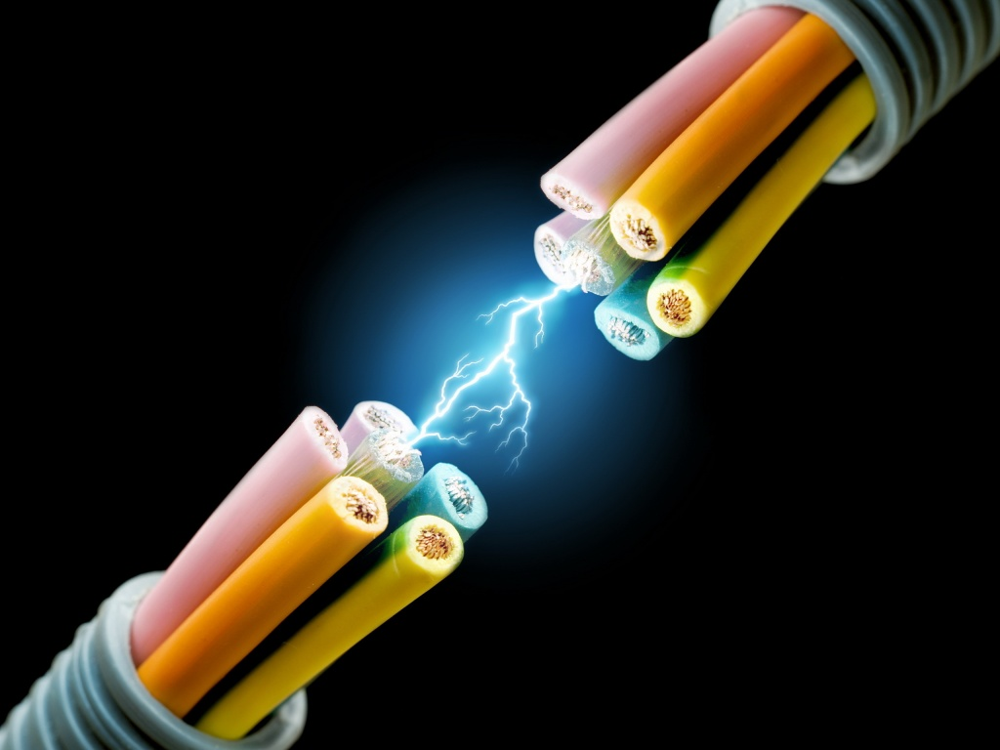
CH 11: Electricity and Its Production
11.3 – Electric Potential Difference

Slide 2
11.3 – Electric Potential Difference

Slide 5
Practice #1 pg. 511

Slide 11
Classwork & Homework

