Slide 2
1.4 – Comparing Graphs of Linear Motion

Slide 9
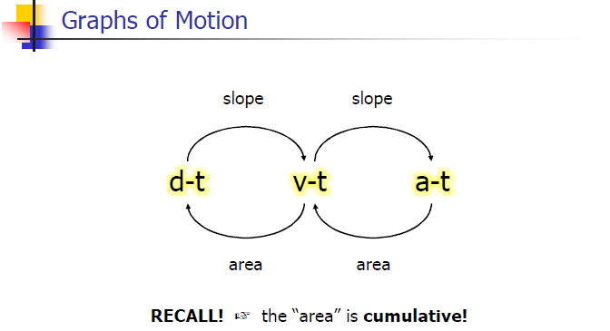

Slide 10
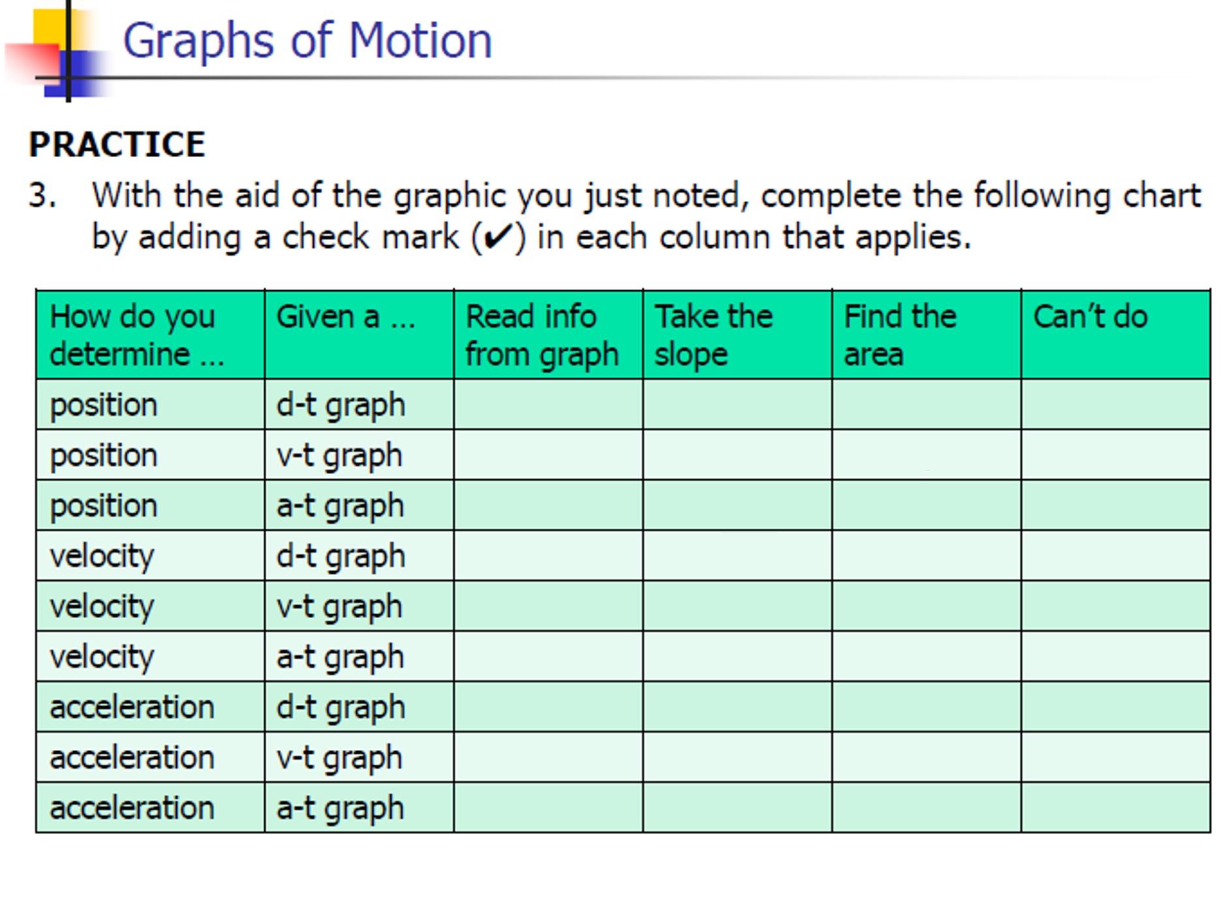

Slide 11
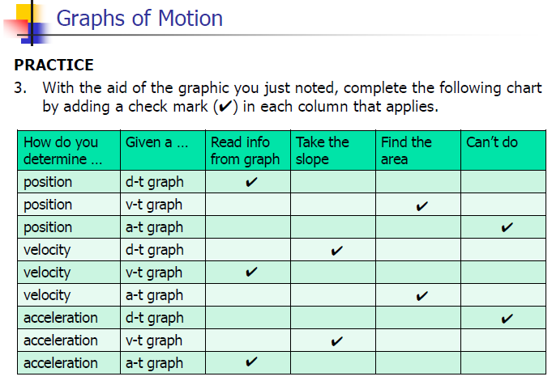

Slide 12
1-D Kinematics
https://youtu.be/UefWw5k4G0U

